Slide 1
Gradient Boosting Machines Model Influence, Hyperparameters, Optimization
2023 CAS RPM GBM Workshop
Marcus Deckert, Gary Wang, Aparna Sree

Slide 2
Part 1: Model Influence

Slide 3

Model Influence Metrics
Gain – scaled measure of the relative contribution of features to the model calculated by taking each feature contribution for each tree in the model. The calculation will not be covered; see footer.
Cover – scaled measure of the relative number of observations used for each feature. If a feature is used in 3 trees with 50, 75, and 100 observations, the unscaled cover = 225. This is divided by all the unscaled covers in the gbm.
Frequency – similar to cover except measure of the number of splits a feature is used in.
SHAP - Method for understanding feature contributions for complex models. Influences are expressed as if using a GLM. This is generally accepted as a feature influence evaluation metric. It accounts for correlations far better than Gain. The following slides show some common SHAP displays.
https://xgboost.readthedocs.io/en/latest/tutorials/model.html

Slide 4
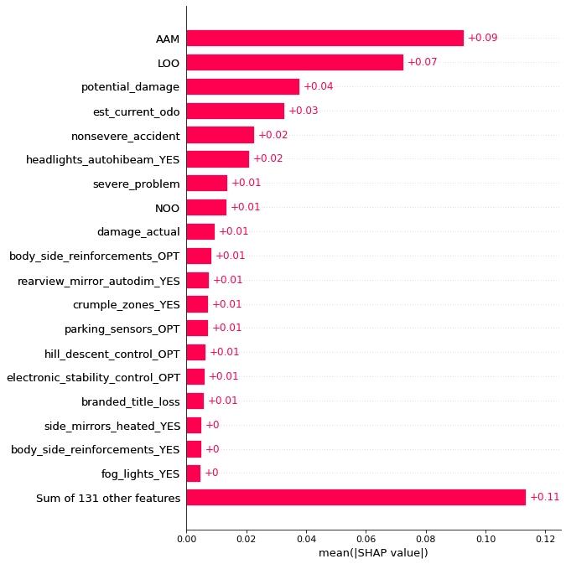
SHAP - Bar
SHAP BAR PLOTS GIVE A SIMPLE EXPLANATION OF THE OVERALL VALUE OF THE FEATURES TO THE MODEL

Slide 5
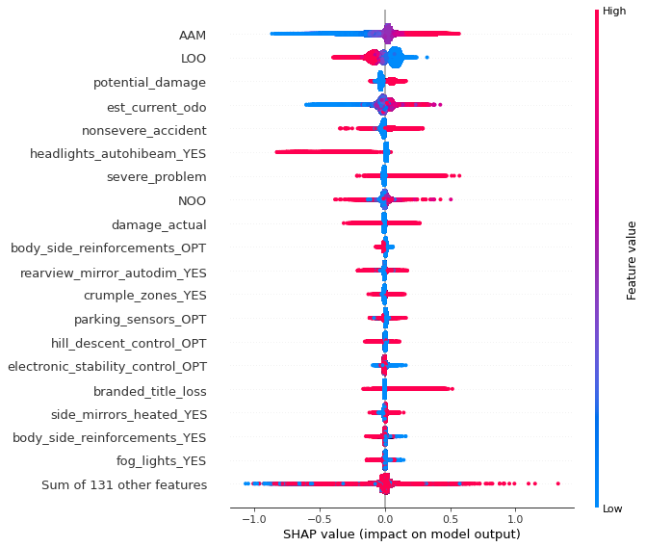
SHAP - Beeswarm
BEESWARM PLOTS ADD DETAIL ABOUT DIRECTION, MAGNITUDE, AND DISTRIBUTION OF PREDICTIONS

Slide 6
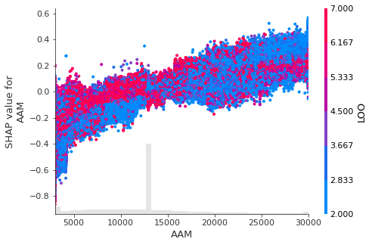
SHAP - Scatter
Annual Mileage is more important for low Length of Ownership.
The rational explanation for this is increased familiarity with the vehicle allowing for better accident avoidance.
MULTICOLOR SCATTERPLOTS ALLOW FOR COMPARING INTERACTION AMONG FEATURES

Slide 7
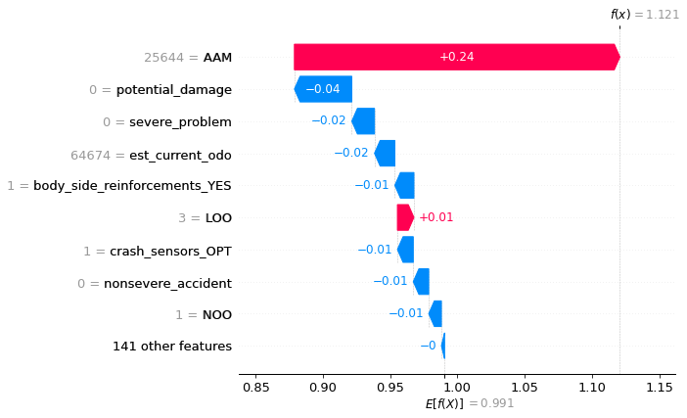
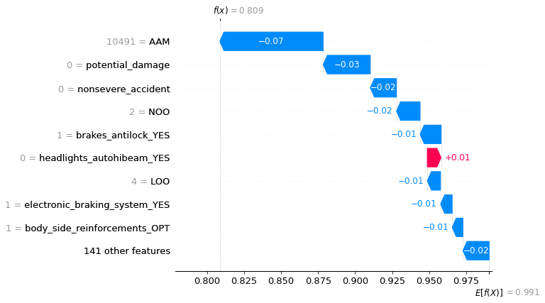
SHAP – Waterfall
VIN ID: 3359641
VIN ID: 4289314
ALLOW EXPLANATION OF NONPARAMETRIC MODEL
RESULTS ON INDIVIDUAL OBSERVATIONS

Slide 8
Part 2: Hyperparameters

Slide 9
Hyperparameters; Overview
Max Tree Depth
Number of Trees
Learning Rate
Min Split Loss
Min Child Weight
Subsample
Lambda
Alpha
Monotone Constraints
Interaction Constraints
Tree Method
Objective
Eval Metric

Slide 10
Hyperparameters; Max Tree Depth & Number of Trees
Max depth is the number of splits allowed in each tree while number of trees/rounds to be created. Increasing both leads to better curve fitting, higher model power, and overfit risk.
Increasing max depth allows the model to find more interactions in the data.
Decrease both for conservatism.

Slide 11
Hyperparameters; Learning Rate
Learning rate (eta) is the multiplier given to the leaf (terminal node) of each tree path which reduces the weight (coefficient/factor) given to the prediction. Increasing this parameter may not necessarily increase model prediction quality.
For example, a leaf whose conditions lead to a 20% discount in the data will only be given a factor of .98 if we use a learning rate of 0.10.
Lower learning rates allow models to generalize better and are less reliant on a few key predictors. Giving the model a chance to “diversify” is beneficial.

Slide 12
Hyperparameters; Min Split Loss, Min Child Weight, & Subsample
Min Split Loss (gamma) is the minimum loss (error) reduction required to continue splitting the tree. Increase for conservatism.
Min Child Weight is the minimum weight (hessian) required to continue splitting the tree. Increase for conservatism.
Subsample is the random % of the data to sample for a tree. Reduce for conservatism.
All of these are designed to allow for more conservative models by restricting the space in which predictions can be made, either by column, row, or weight.

Slide 13
Hyperparameters; Lambda & Alpha
Lambda (L2) is a regularization term on the weights. Increase for conservatism. L2 regularization is used in Ridge GLM and is used to move feature coefficients toward 0, but not eliminate them entirely. It may make some features essentially obsolete.
Alpha (L1) is another regularization term on the weights. Increase for conservatism. L1 regularization is used in Lasso GLM and is used to eliminate features. It’s essentially an automated feature reduction parameter.

Slide 14
Hyperparameters; Monotone Constraints
Monotonicity can be enforced in GBM models but in practical experience I have found it to be imperfect. For the most part, the model will adhere to the constraints.
Due to multicollinearity, some monotonicity settings may end up being partially ignored/dampened with the effect being larger for deeper trees.
In other cases, I have seen behavior where the resulting node prediction follows monotonicity while the actual split in question violates it.
For best adherence, preprocess data in larger buckets and ensure the one way signal appears as desired. This along with monotone constraints will lead to minimal monotonicity violations in practice.

Slide 15
Hyperparameters; Interaction Constraints
Interaction constraints allow us to specify which features can interact with other features. Although tedious to setup, if we want maximum control on what is allowed to interact with what, it can be done.
Suppose we var features [0,1,2,3,4,5,6] in the model (I am referencing their indices). We only want 0 & 2, 1 & 3 & 4, and 5 & 6 to interact with each other.
We would need to input the following:
[ [0,2] , [1,3,4] , [5,6] ]

Slide 16
Hyperparameters; Tree Method
Tree methods available:
Exact – Greedy algorithm. Longest runtime but maximum power.
Approx – Uses quantile sketch and gradient histogram.
Hist - Histogram optimized approximate greedy algorithm.
GPU_Hist – hist method but using GPU. There is more information available on using GPU in the XGBoost documentation.
Approx makes new bins for each iteration, while hist reuses old bins for continuous features.
Hist method is very similar to LightGBM implementation.

Slide 17
Hyperparameters; Objective & Eval Metric
Objectives
reg:squarederror, reg:squaredlogerror, reg:logistic, reg:pseudohubererror, reg:absoluteerror, reg:gamma, reg:tweedie
binary:logistic, binary:logitraw, binary:hinge, count:poisson
survival:cox, survival:aft, aft_loss_distribution, multi:softmax, multi:softprob, rank:pairwise, rank:ndcg, rank:map
Eval Metrics
rmse, rmsle, mae, mape, mphe, logloss, error@t, merror, mlogloss
auc, aucpr, ndcg, map, poisson-nloglik, gamma-nloglik, cox-nloglik
gamma-deviance, tweedie-nloglik, aft-nloglik, interval-regression-accuracy
There are so many to choose from – these lists are here to show how flexible XGBoost framework is and how it can be used for many use cases besides the one being shown today.

Slide 18
Part 3: Optimization Process

Slide 19
Optimization Overview
We must optimize hyperparameters either on a separate test set (and what we consider to be “test” now gets named “validation”) or preferably, use cross validation.
K-fold cross validation typically uses the LOO (leave one out) process where we create 5 train/test splits within the training data. The test set for each fold is a different 20% of the training data.
We can then evaluate the model fit, lift chart, etc… using only the training data. This keeps our actual test/validation set unused.

Slide 20
Gridsearch
In order to determine the optimal set of hyperparameters, we perform one or more gridsearches.
The gridsearch involves fitting models with the permutations of selected hyperparameters. For example we may try learning rates = [.01, .10, .25], number of trees = [50, 100, 200], max_depth = [4, 6, 8], and tweedie p value = [1.4, 1.5, 1.6]. This will result in 3^4 or 81 combinations.
We then compare how well the models fit given the hyperparameters. We can do this a few times to find the best set of hyperparameters.
The following slide will show a display used to evaluate this gridsearch process. This display is just one way to evaluate model fit and prediction stability.

Slide 21
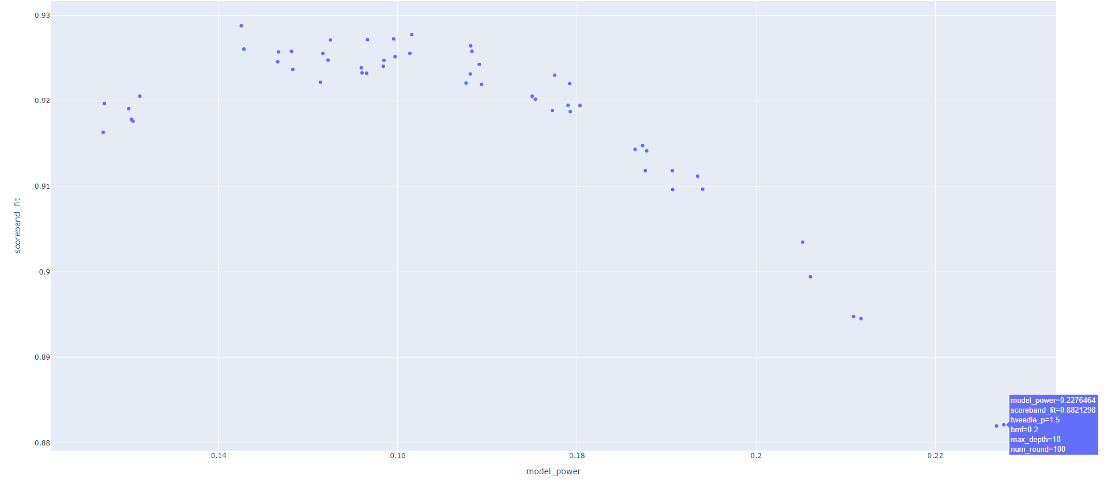
Gridsearch & Cross Validation
Fit quality (Y-axis) is a measure of the error between actual and predicted. Model power (X-axis) is a measure of the weighted total prediction power of the model. We are looking for a model that is a good blend of both. This efficient frontier is a great example of Bias-Variance tradeoff; the more powerful the model, the less well it fits.

Slide 22
Reference
XGBoost: https://xgboost.readthedocs.io/en/stable/index.html
SHAP: https://arxiv.org/pdf/1705.07874.pdf

